Slide 1
CIFAR10 IMAGE Generation
By: Yee Hang
Objective : to create an generative adversarial network that creates images with decent fidelity

Slide 2
Background Generative adversarial network (GAN)
https://machinelearningmastery.com/impressive-applications-of-generative-adversarial-networks/
- GAN can generate images with high fidelity and are used in image upsampling, image resolution and generating more image samples for normal classifiers
- For image generation models , GANs succeed the Variational Autoencoders(VAEs) as they are found to create more realistic images but require longer training .
- It consist of a generator network and discriminator network that is training in a zero sum game, where the gain of the discriminator is the loss of the generator and vice versa
Generator
- The generator learns to generate images that look real enough to fool the discriminator
Discriminator
Learns to classifies between real images from generated images
Has a much easier task than generator as It only has to classify between real and fake images
Usually overfits and 'overpowers' and thus does not provide useful feedback the generator making the generator unable to learn , hence it is important to ensure balance between the 2 networks.
Training Loop (in general):
2 phases, one phase to update discriminator weights and another to update generator weights
1)Generator uses gaussian noise to produce a batch of fake images
2) Discriminator takes in a batch of real of real and generated images and classifies them and ONLY weights of discriminator is updated.
3)Process repeats where generator produce fake images and discriminator classifies them but only weights of generator updated
Separately updating the weights of both networks prevents them from hitting a moving target

Slide 3
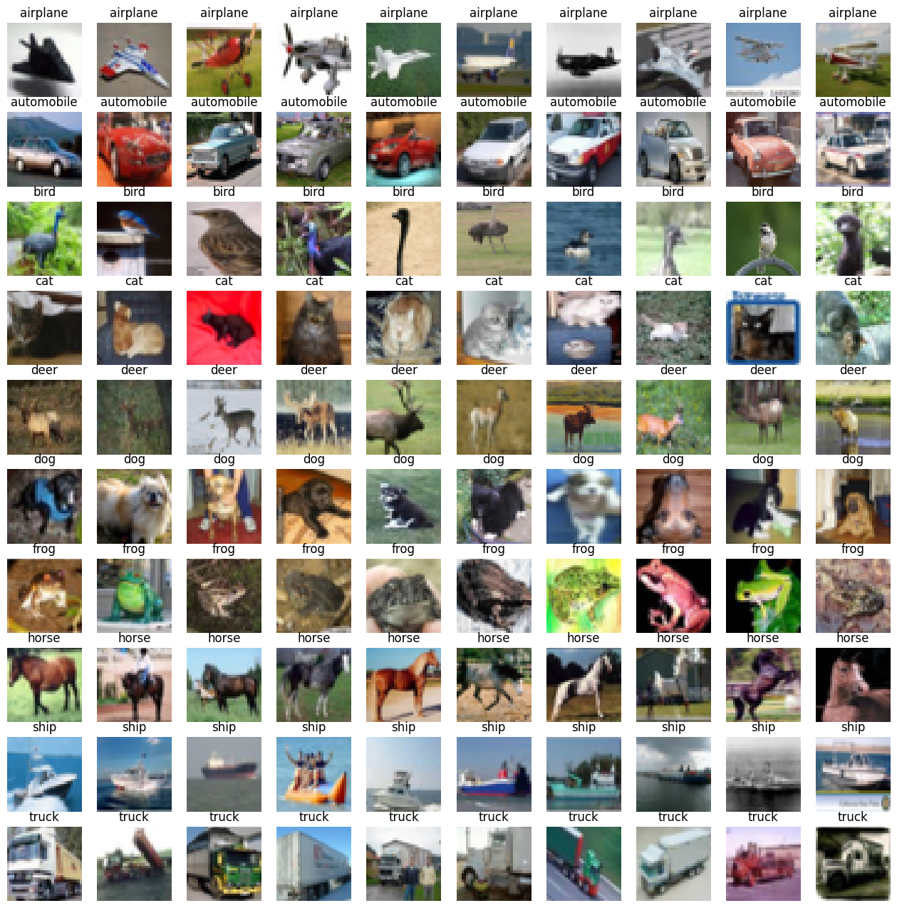
CIFAR10 Dataset Info, Looking at the images
This is a dataset of 50000 training images and 10,000 test images
Each image is 32x32x3 (LxWxH)
contains 10 classes
Generally animal images are more blurry , especially frogs and deer and horse
Vehicles are generally clearer / less fuzzy

Slide 4
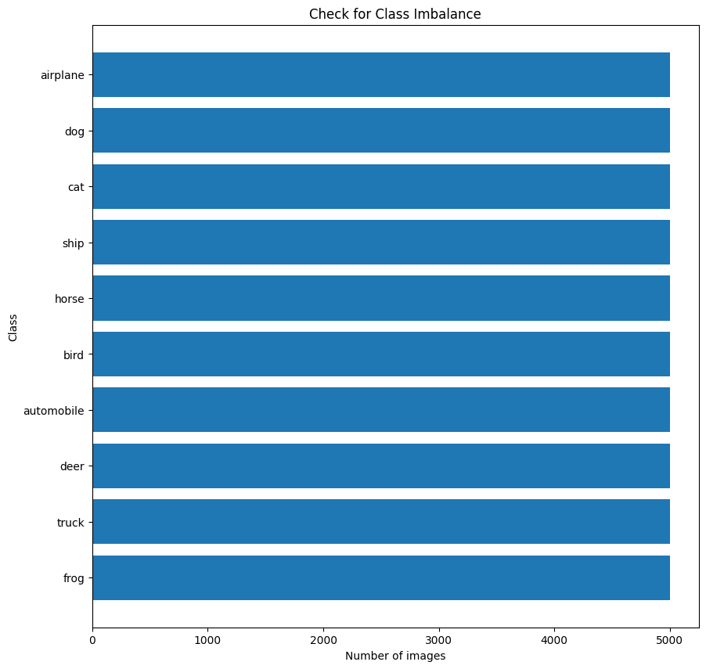
Check for class imbalance – 10 classes
The cifar 10 dataset has 5000 images per class which is sufficient for this task but we have to take note of the discriminator overfitting and not providing useful feedback as cifar10 is still considered a small dataset

Slide 5
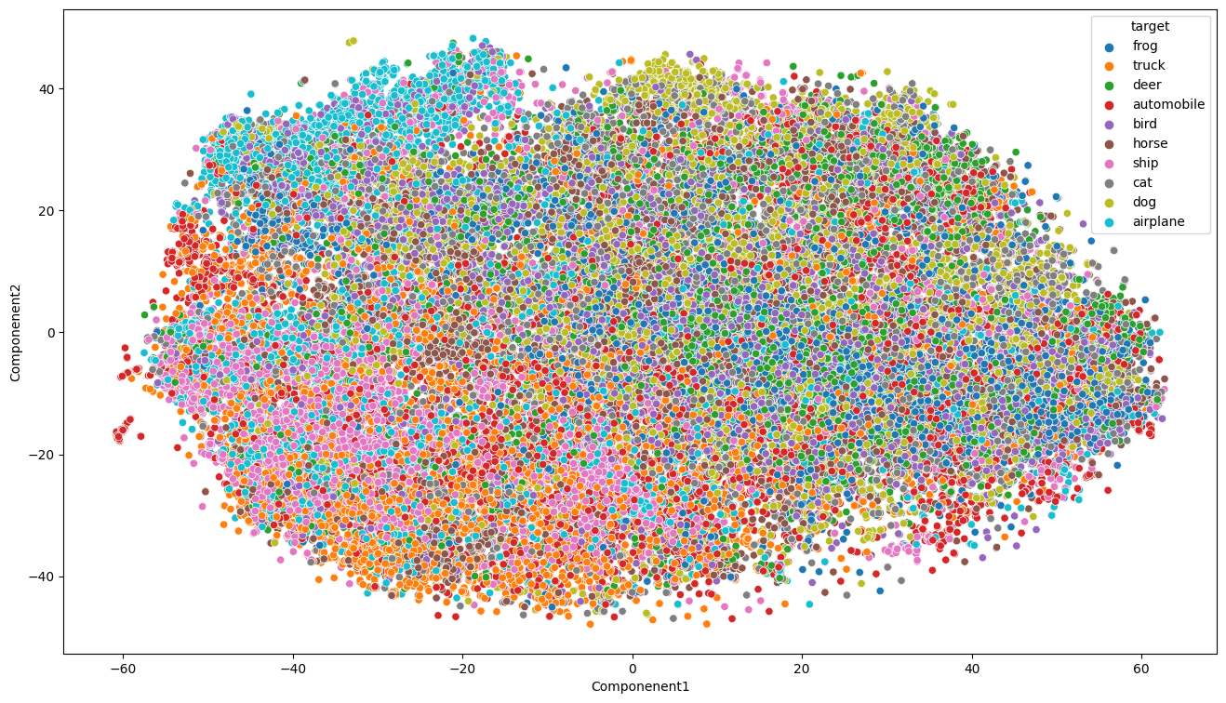
TSNE - Visualising all images in dataset
- TSNE is a method for visualizing high dimensional data using manifolds
- Images are flattened and passed into tsne
- Air planes are more well separated from the rest of the classes occupying the top left corner
- Frogs and cats overlap with a lot of other classes and very widely spread out across the space
- Automobile also spread out across the space
- Truck and ship more distinct from the rest (occupying the bottom left corner), but overlap with each other

Slide 6
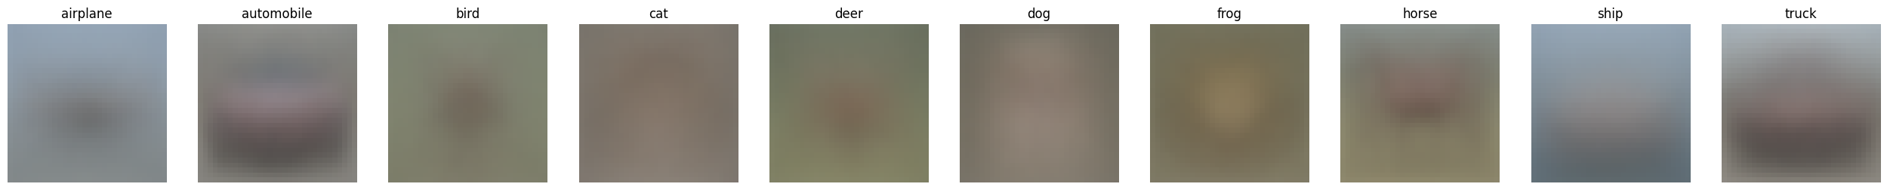
Average image per class
Classes that are less similar will be more blurry and vice versa
The automobile and horse looks slightly more clear, showing that within the classes the images look more similar
Airplane, ship and truck images looks to be more in the center, which will make it easier for the gan to generate the images there
Cat, dog and frog images seem to have higher variety as it looks very blurry, cannot see even a silhouette of of these animals

Slide 7
Modelling - Data Preprocessing
Get the pixel values by `(img -127.5)/127.5` to get the images in the range of -1 and 1 so that the scale of real images is the same as the generated images passing through the last layer of tanh from -1 to 1 .

Slide 8
Modelling - Frechet inception distance
Most common metric for evaluating GAN
The fid is a metric that compares the difference in mean and variance (of real and generated images) of the image features extracted by `InceptionV3`.
It is more reliable then its predecessor the Inception Score which only calculates based on the features extracted of the generated images only
As it uses both mean and variance of the features, a low FID is only achieved when the images have similar quality and diversity to the CIFAR10 dataset.
It assumes a gaussian distribution
FID can be biased for small datasets like cifar10

Slide 9
Modelling - Kernel inception distance
Measures the Maximum Mean Discrepancy between the real and generated images
The KID improves on the FID by relaxing the gaussian requirement as it is a non parametric test

Slide 10
Modelling
Use both metrics to evaluate the models
Calculate KID every epoch to check if image quality is improving as training proceeds (it is less biased and less computationally expensive)
Calculate the more computationally expensive FID after training each model as it is more interpretable than KID

Slide 11
Modelling – Baseline Vanilla BCE GAN
Conv2dTranspose layers are avoided from the start
Conv2dTranspose layers with stride of 2 can upsample the images by doubling the size of them, but will produce artifacts
Architecture:
No skip connection
Blocks of Upsampling layers with convolution layers afterwards
Using Leaky ReLu (sparse gradients caused by normal ReLu causes instability
Using Batch Normalisation in both generator and discriminator will make convergence faster in GAN
Hyperparameters:
Adam optimizer with 0.0002 learning rate as the original learning rate of 0.001 is too large, and often causes divergence
Batchsize 128 which is the trade off between convergence time and convergence quality

Slide 12
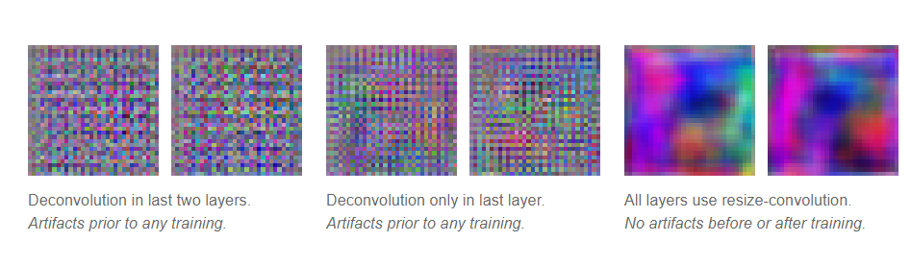
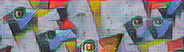
Modelling – Baseline Vanilla BCE GAN
Image generated by a style gan 2.
Images look decent but have artifacts
Avoid Conv2dTranspose
Conv2dTranspose layers with stride of 2 can upsample the images by doubling the size of them, but will produce artifact
Above shows untrained generator with conv2dtranspose at the last 2 layers
This shows that the convtranspose2d will produce artifacts (checkerboard patterns) , and it is due to the uneven overlap of the layers and not due to the adversarial training
Use upsampling with one or multiple Conv2d layers afterward

Slide 13
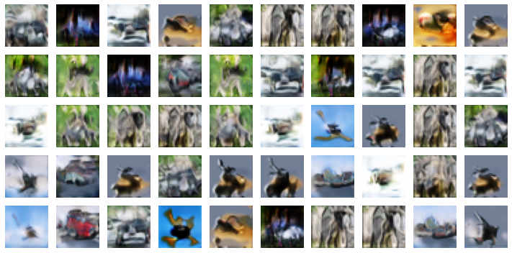
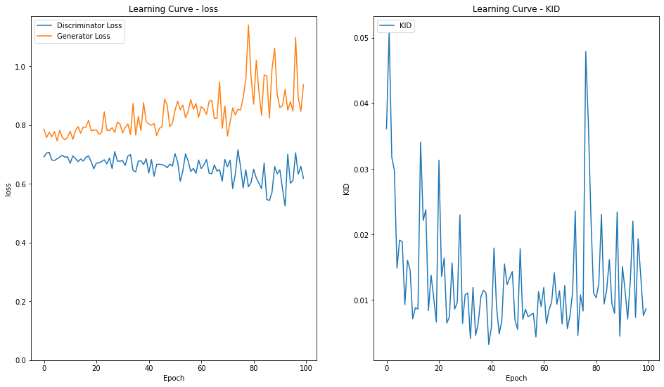
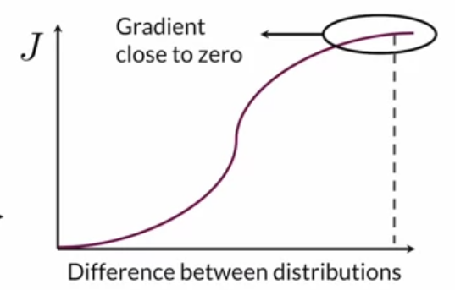
BASELINE – Vanilla BCEGAN
Training is very unstable , the discriminator and generator does not learn after around 10 epochs, as discriminator and generator loss is stagnant afterwards
Kernal inception distance is also very unstable as there are some very large fluctuations
This is most likely due to the gradient vanishing for the binary cross entropy loss used
mode collapse present as images look very similar
The main problem is the flat regions of the Binary Cross Entropy loss function causes the gradients to train the generator to vanish and the training stops.
High Fid of 125,kid 0.01
Notes:
PCA generates new features that are orthogonal to each other , and not correlated with each other

Slide 14
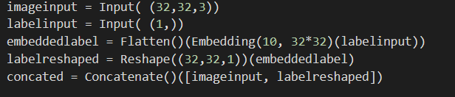
WGAN –GP with conditioning
Adding Conditioning
https://arxiv.org/pdf/1701.00160.pdf
Adding conditioning to labels to make the generation of gan more specific and improve image quality, according to NIPS2016
Using embedding layer for both discriminator and generator
Notes:
PCA generates new features that are orthogonal to each other , and not correlated with each other

Slide 15
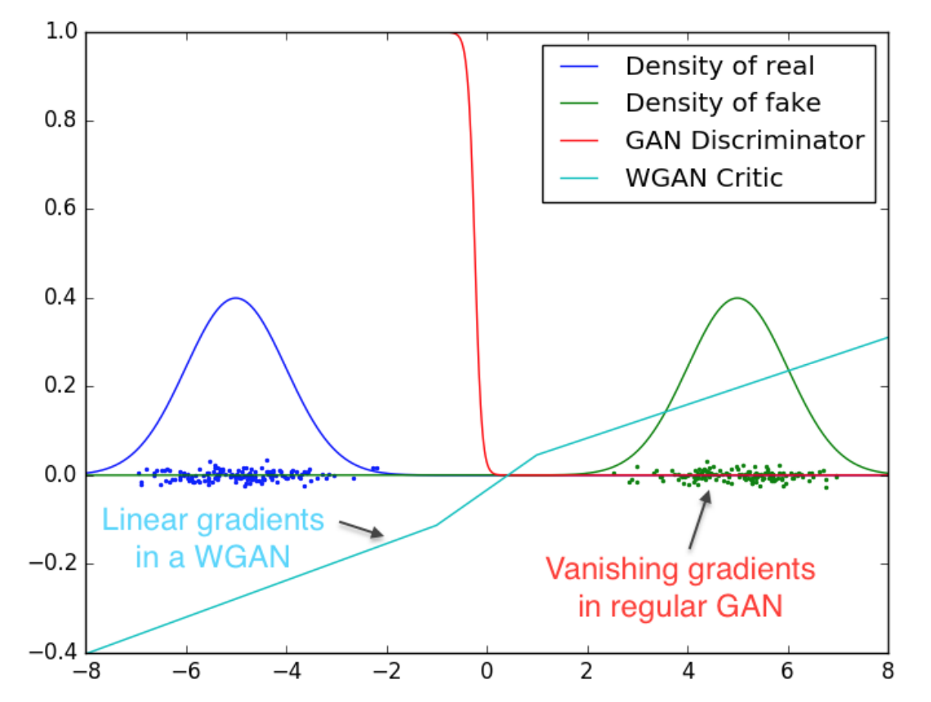
WGAN –GP with conditioning
New loss function (Wasserstein Loss)
An approximation of the Earth-Mover's distance that ensures that gradients are smoother compared to the original binary cross entropy loss - Instead of using sigmoid activation in the last layer and classifying images as true and false directly, the discriminator/critic in the WGAN assigns values (from -infinity to infinity) to real and fake images and the discriminator loss function is tf.reduce_mean(fake_predictions) - tf.reduce_mean(real_predictions) which maximises the difference between the distribution of real and fake images
- Also found to alleviate mode collapse
Notes:
PCA generates new features that are orthogonal to each other , and not correlated with each other

Slide 16
WGAN –GP with conditioning
Wasserstein loss requires that 1-Lipschitz Continuity
To enforce 1-Lipschitz Continuity
The Lipschitz continuity should be enforced to prevent gradients from becoming too large
Weight Clipping
Weight clipping sets explicit limits that the weights cannot exceed
It will limit the performance of the gan especially, as weights cannot exceed a certain fixed value
Gradient Penalty https://arxiv.org/abs/1704.00028v3
adds an extra term of gradient penalty by using interpolated images
It penalize the norm of gradient of the discriminator,thus preventing gradients exploding
Found experimentally to produce better results than weight clipping
Decided to try this method of enforcing 1-Lipschitz continuity
Batch normalization removed from discriminator, as batch correlation in batch normalization makes the gradient penalty fail
Notes:
PCA generates new features that are orthogonal to each other , and not correlated with each other

Slide 17
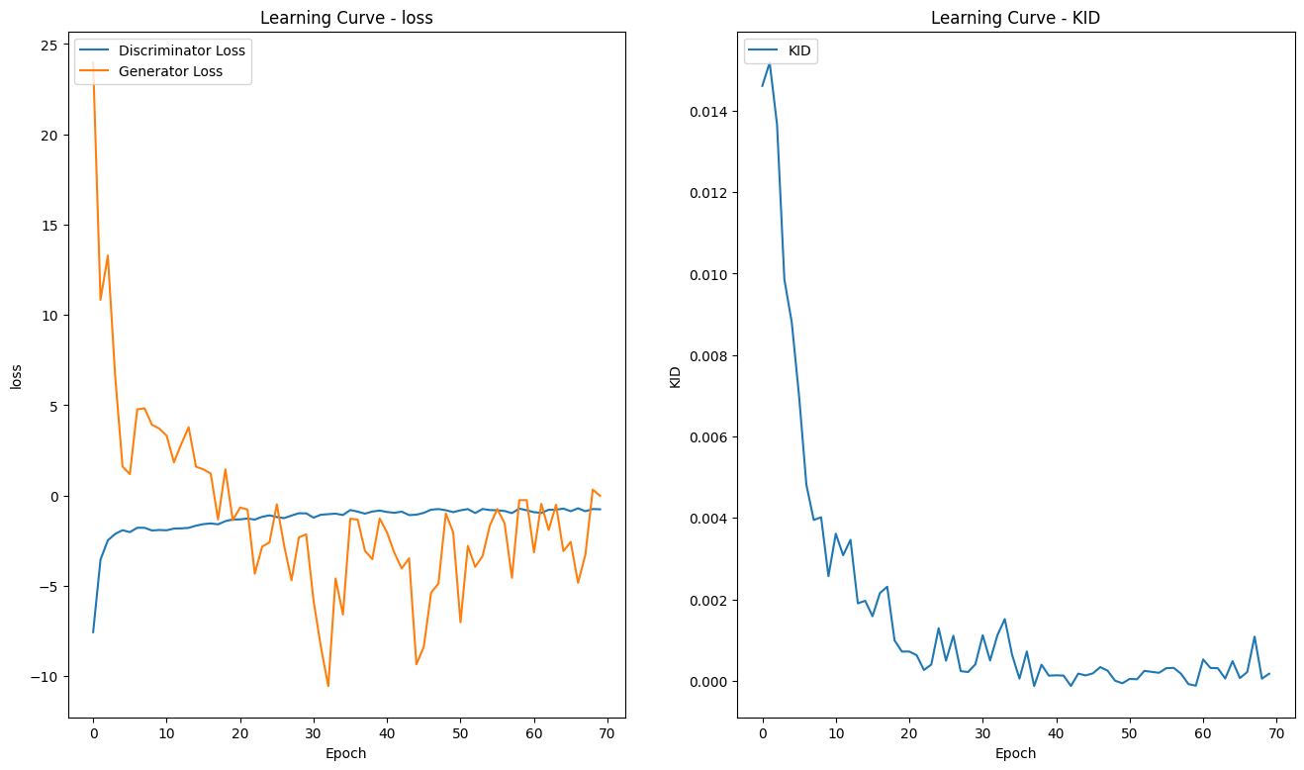
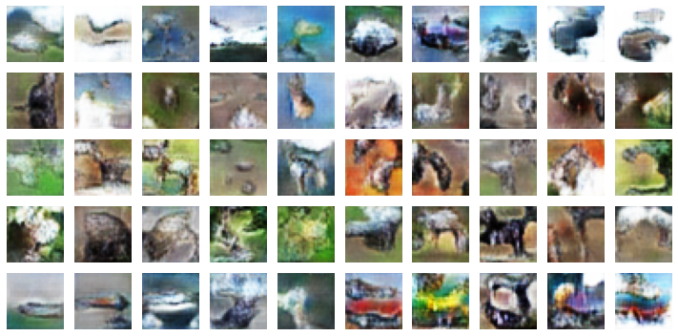
WGAN –GP with conditioning
In term of the generated images, the images from different classes look similar, showing mode collapse , it also suggests that the conditioning method might not be working well
Kid decreases steadily and a lot more stable than the baseline
Discriminator loss is stable
The generator loss is less stable and fluctuates more
Attempt to find a more stable architecture of discriminator and generator
Still poor image quality, but the general colors of each class can be seen
blue sky for the plane and green grass land for the animal background
Achieved FID of 69,kid of 0.001
Notes:
Pca is also able to remove the noise in the data, by excluding the principle components that capture very little variance. 4
There are presence of outliers for torque and rotation speed , but these are mostly faultly machines, which make sense, as machines that are spinning too fast will probably break down.

Slide 18
WGAN GP – Resnet + Larger Architecture
Conditional BatchNorm (generator)
https://arxiv.org/pdf/1707.00683v3.pdf
To improve from using just embedding layers at the start
Normal Batchnorm are used to stablise gan training , thus making convergence faster
Just like simple concatenation and using embedding layers at the start,
For Conditional BatchNorm, each class has its own weight and bias, and each class has its own value of beta and gamma
Found to be more stable in terms of conditioning the generator
Increasing the architecture size and type
I change the architecture to add skip connections in both the discriminator and generator (ResNet), when I increase the layer size
Skip connections in each resnet block allows for better information flow , leading to better information flow
Notes:
Pca is also able to remove the noise in the data, by excluding the principle components that capture very little variance. 4
There are presence of outliers for torque and rotation speed , but these are mostly faultly machines, which make sense, as machines that are spinning too fast will probably break down.

Slide 19
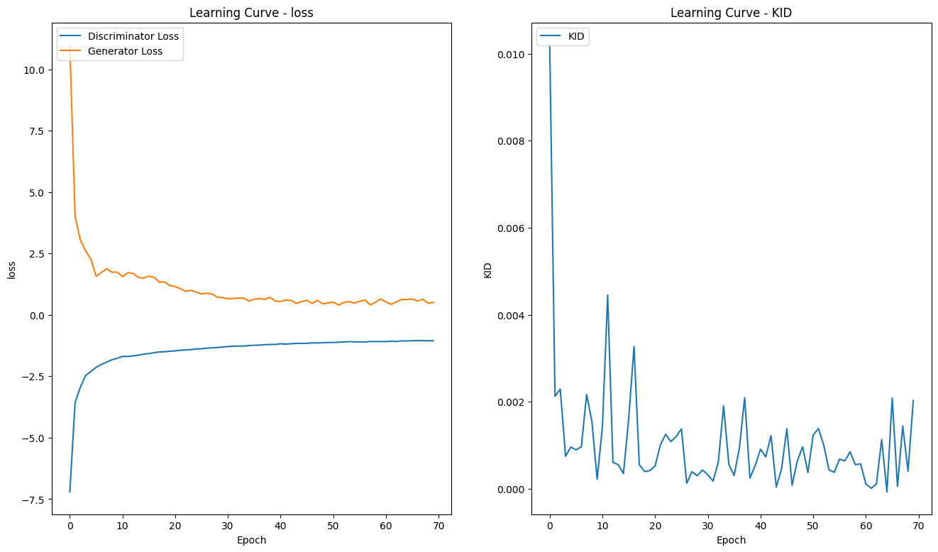
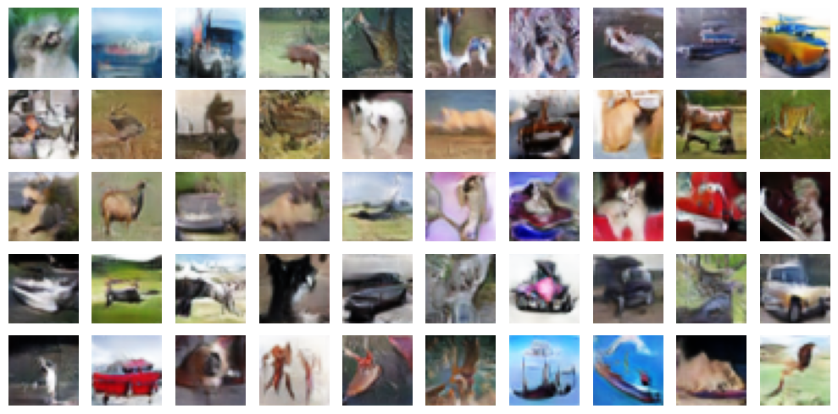
WGAN GP – Resnet + Larger Architecture
The generator loss is more stable, than the previous architecture , and steadily decreases and does not have spikes
towards the end, the losses are stagnant which shows successful convergence
the images generated have less of the problem of the classes joined together
The general shape of deer and automobile can be seen, but still generally blurry
WGAN –GP is quite expensive as it requires extra calculation of gradients and requires the 5 discriminator steps per generator step, attempt methods that are less computationally expensive
Fid of 30 and kid of 0.001
Notes:
Pca is also able to remove the noise in the data, by excluding the principle components that capture very little variance. 4
There are presence of outliers for torque and rotation speed , but these are mostly faultly machines, which make sense, as machines that are spinning too fast will probably break down.

Slide 20
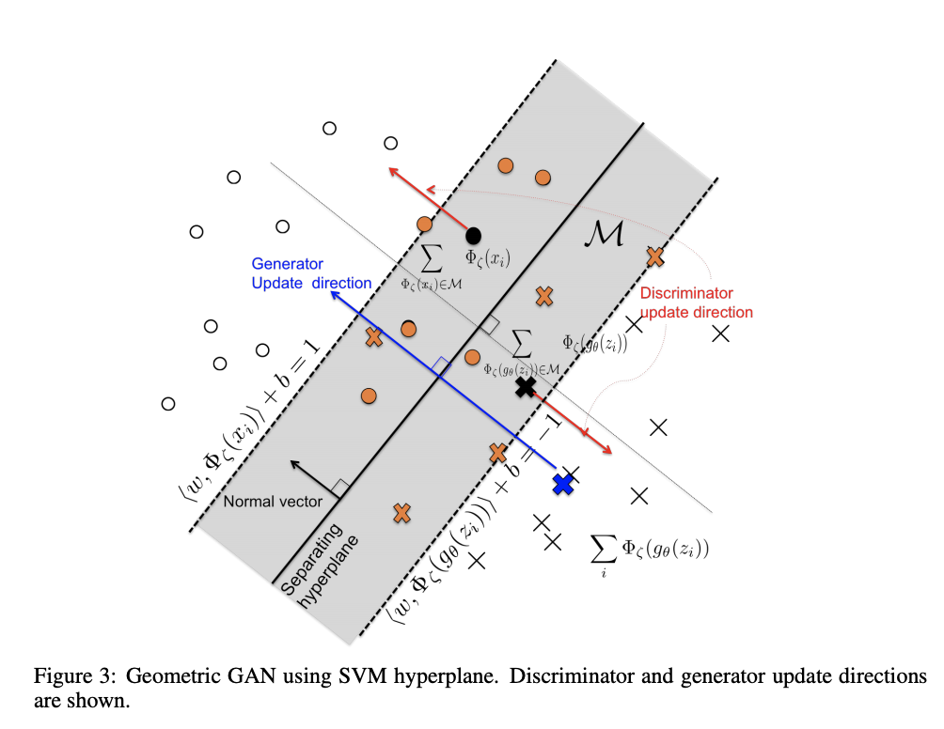
Hinge GAN
Spectral Normalisation
https://arxiv.org/pdf/1802.05957v1.pdf
it is a weight normalization technique that prevents vanishing/ exploding gradients, by rescaling the weight tensor with spectral norm σσ of the weight matrix
It is an alternative to using gradient penalty to enforce the 1-Lipschitz Continuity, thus another method to stabilizing the training
It is computationally cheaper than gradient penalty, thus allowing better performance in shorter amount of training time
Loss function : the Spectral Normalization paper achieved best results with hinge loss, so I tried the hinge loss mentioned above
Hinge Loss
https://arxiv.org/pdf/1705.02894.pdf
Based on support vector machines classifier
The discriminator learns a boundary between real and fake samples, that the real and generated images are the furthest apart
The generator will generate images closer to the boundary found by the discriminator
It is shown in paper that it increases stability and alleviates mode collapse
The "theoretical results" in the paper also shown that Nash equilibrium between discriminator and generator is achieved (when none of the networks can make the other improve further)
Notes:
Pca is also able to remove the noise in the data, by excluding the principle components that capture very little variance. 4
There are presence of outliers for torque and rotation speed , but these are mostly faultly machines, which make sense, as machines that are spinning too fast will probably break down.

Slide 21
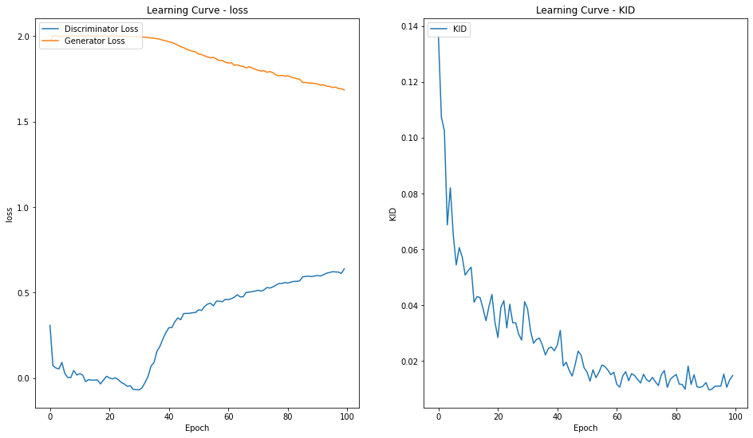
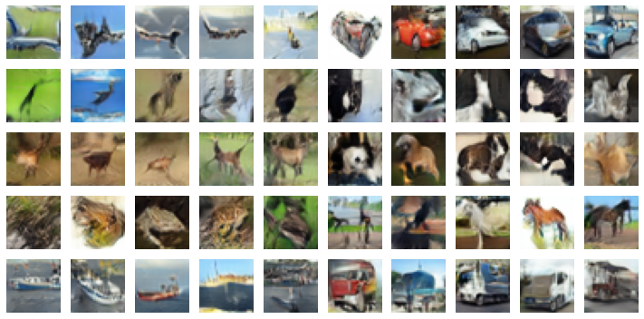
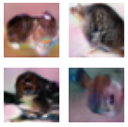
Hinge GAN
The discriminator loss and generator loss increases and decreases gradually showing stable training and neither of the networks overpower the other one , showing that the current network architectures are balanced
The Kernel inception distance decreases from start of training to around 60 epochs, the kid is stagnent after 60 epoch
FID score also improved by 10 from the WGAN-GP (20.35), kid 0.02
Some of the images generated have a pinkish tint to it which makes the images look weird.
Most of the cifar10 images dont have that color
Pinkish tint
Notes:
Pca is also able to remove the noise in the data, by excluding the principle components that capture very little variance. 4
There are presence of outliers for torque and rotation speed , but these are mostly faultly machines, which make sense, as machines that are spinning too fast will probably break down.

Slide 22
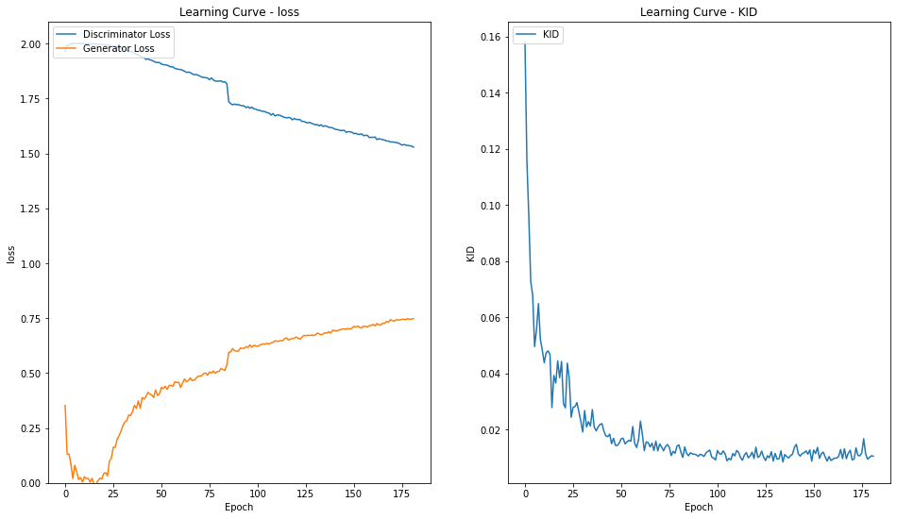
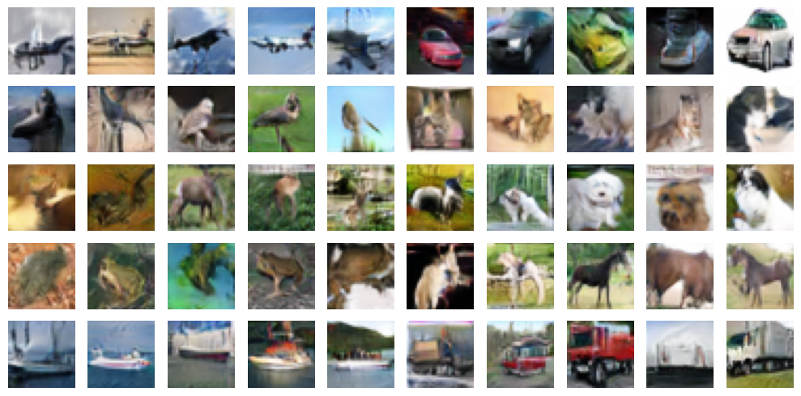
Hinge GAN – RLC Regularisation
RLC regularisation Regularizing Generative Adversarial Networks under Limited Data https://arxiv.org/pdf/2104.03310.pdf
-Cifar 10 is a smaller dataset, which means the discriminator more prone to overfitting,
RLC regularization term is added to the discriminator loss to regularize the discriminator
This is appropriate this regularization method is to regularizing the discriminator when there is limited data, and the paper authors propose this as alternative to data augmentation (very computationally expensive) , which is not feasible in this case due to hardware and time constraints
Analysis
I realize that although the system is converging, but it is doing so very slowly, hence, I decrease the learning rate to 0.0002 /4 = 0.00005 after 80 epochs leading to decrease in discriminator loss and increase in generator loss and make them closer to convergence.
The rlc regularization achieved a slight improvement in performance with FID of 18.74, kid 0.02
The pinkish tint seemed to be removed with the addition of the RLC regularization
From images generated during training above, the dogs, vehicles and horses and birds look quite realistic
Images are generally diverse showing no mode collaspe
Final model as it has the best fid and image quality (from looking at generated images
Notes:
Pca is also able to remove the noise in the data, by excluding the principle components that capture very little variance. 4
There are presence of outliers for torque and rotation speed , but these are mostly faultly machines, which make sense, as machines that are spinning too fast will probably break down.

Slide 23
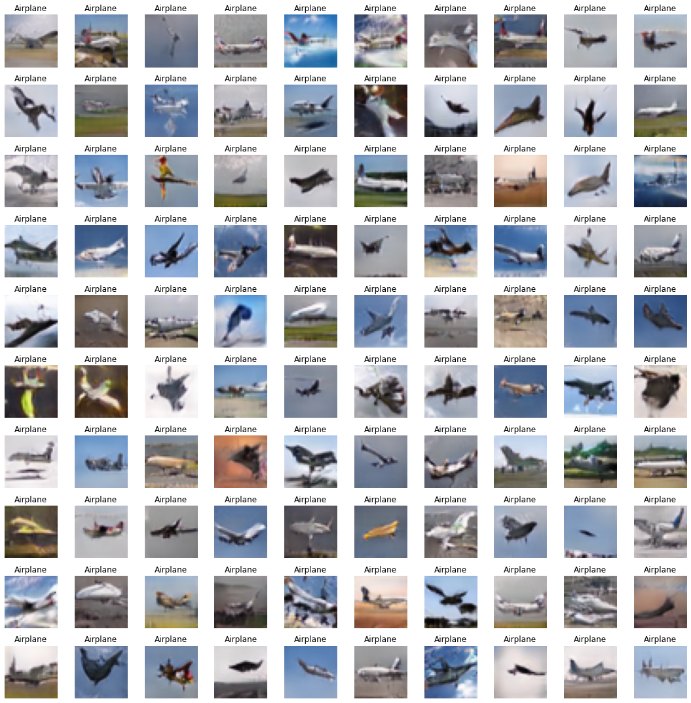
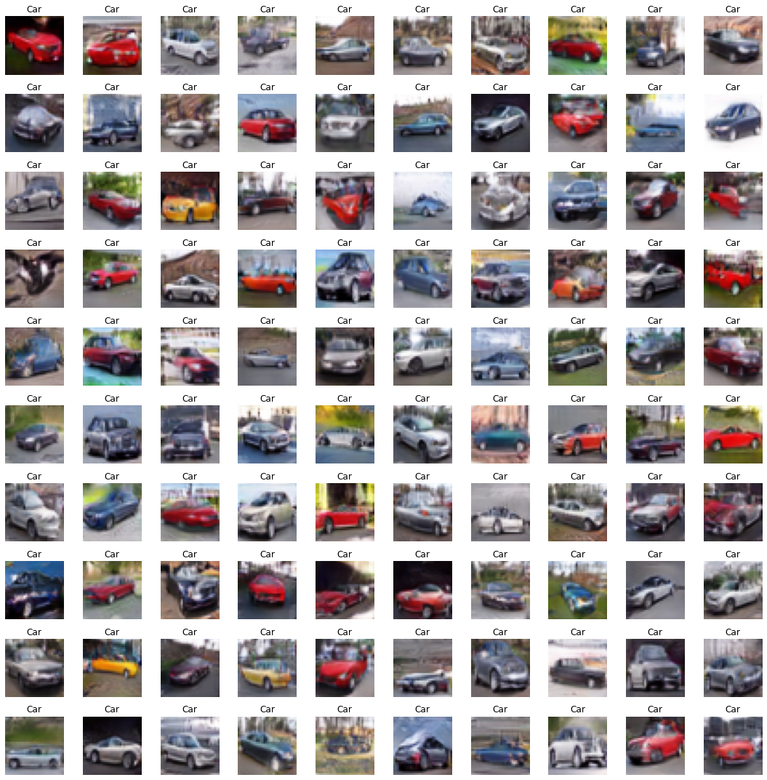
100 image per class, Vehicles (Plane, Car)

Slide 24
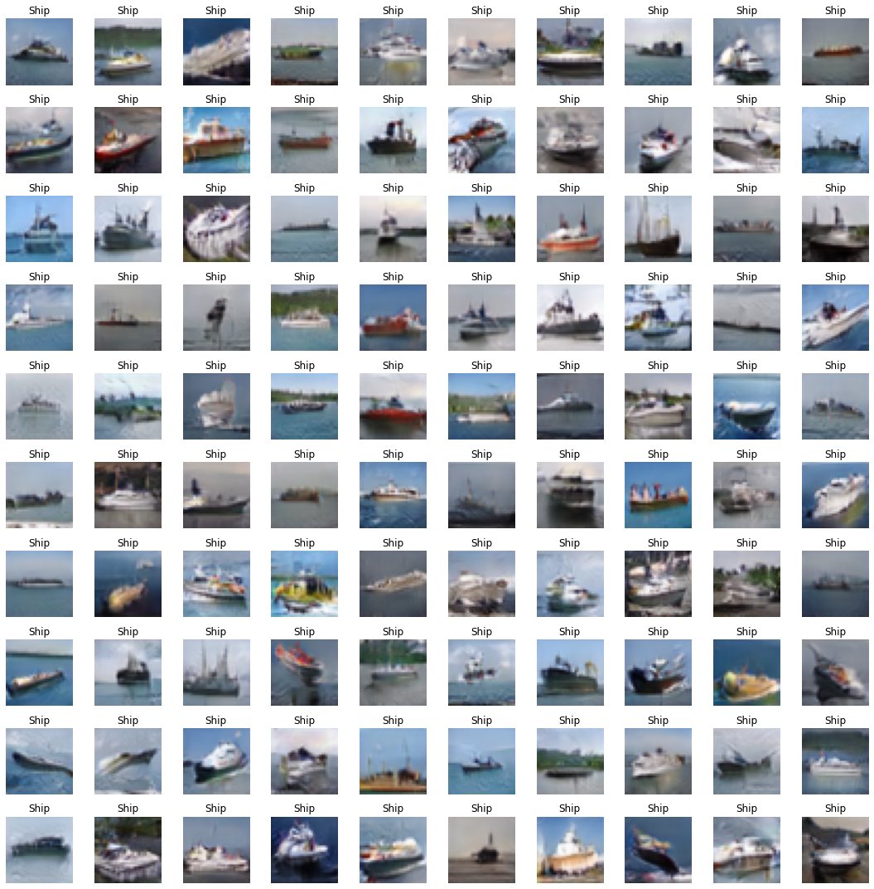
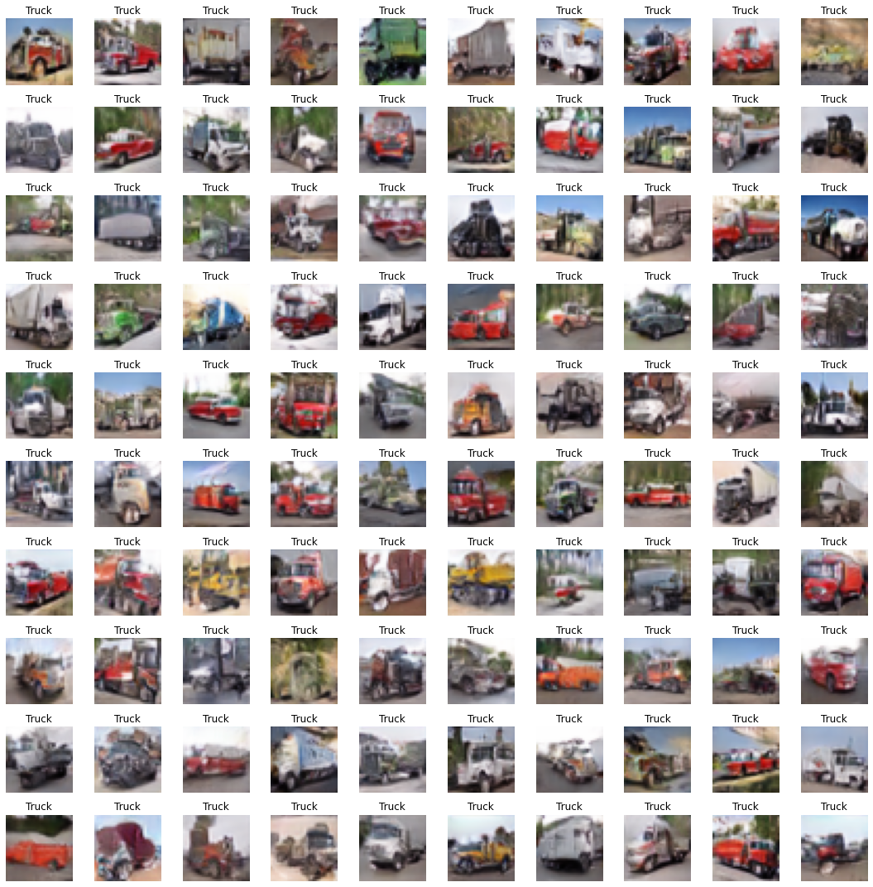
100 image per class, Vehicles (Ship, Truck)
Generally looks realistic for vehicles especially ship

Slide 25
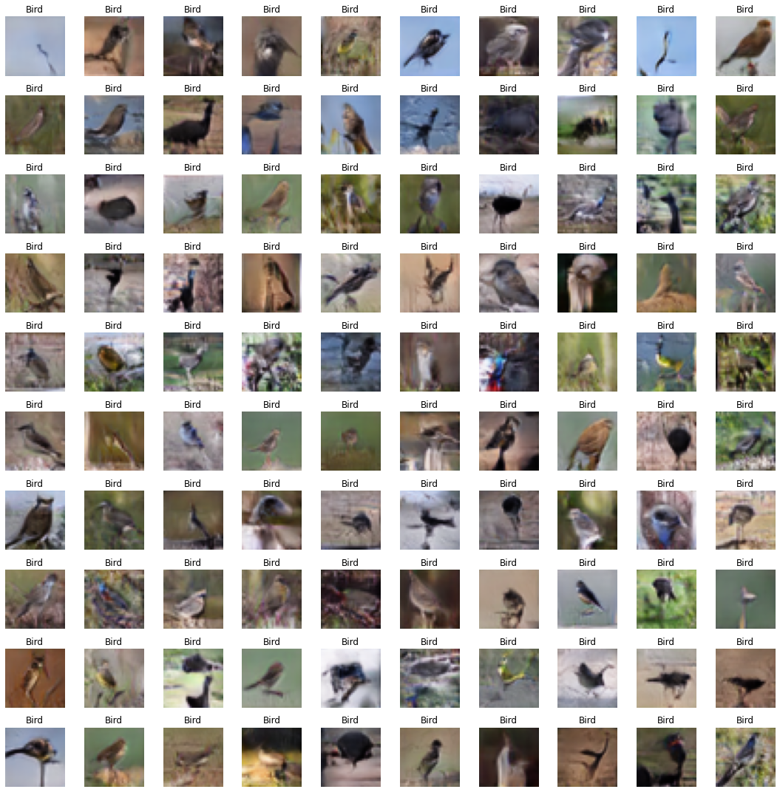
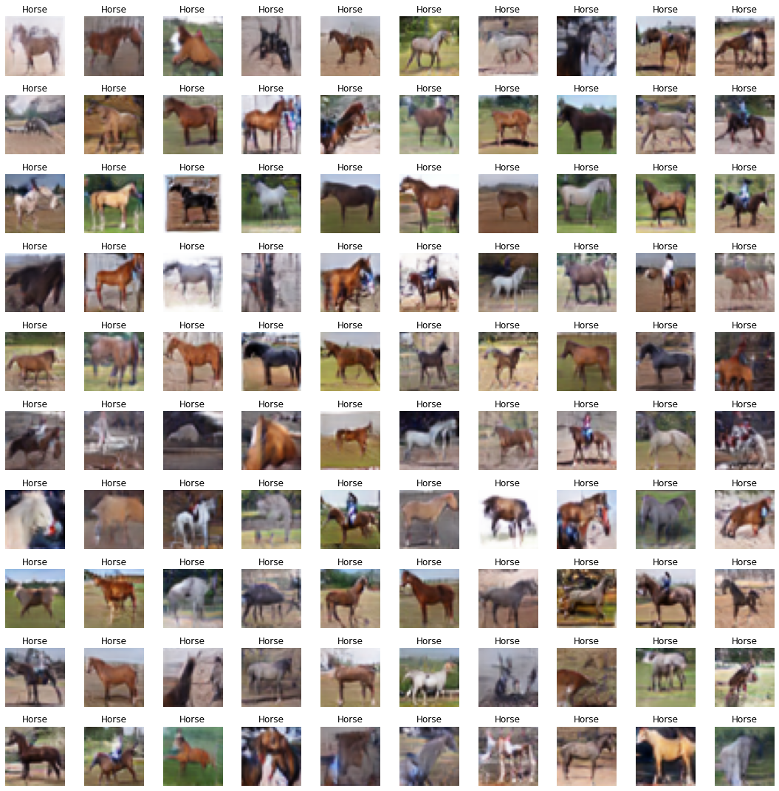
100 image per class, (Bird, horse)
Images also look realistic for bird and horse

Slide 26
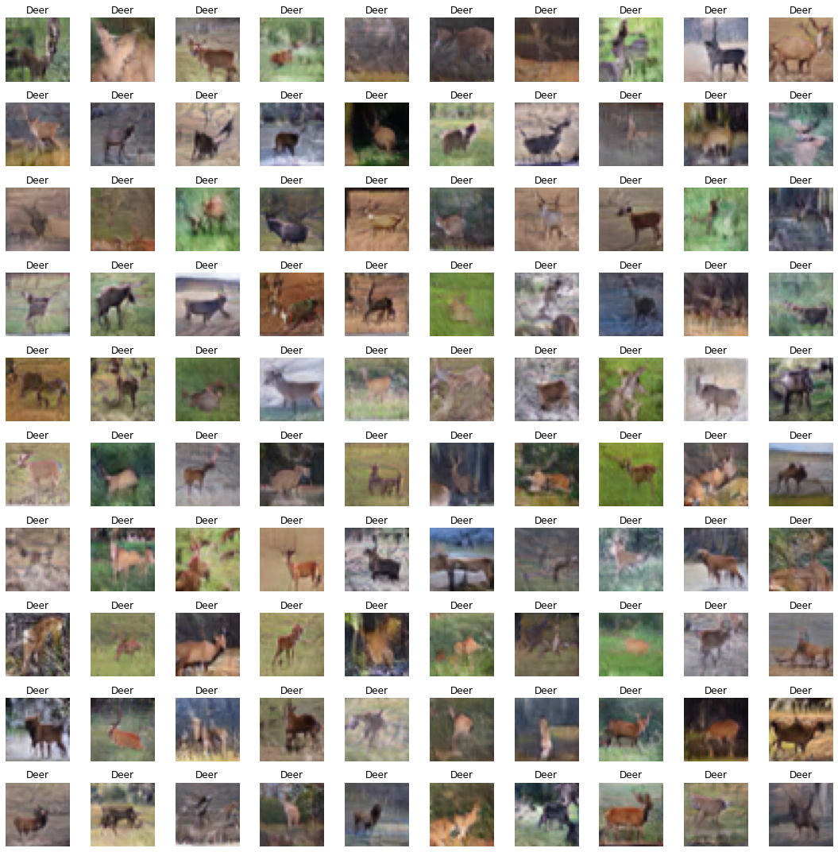
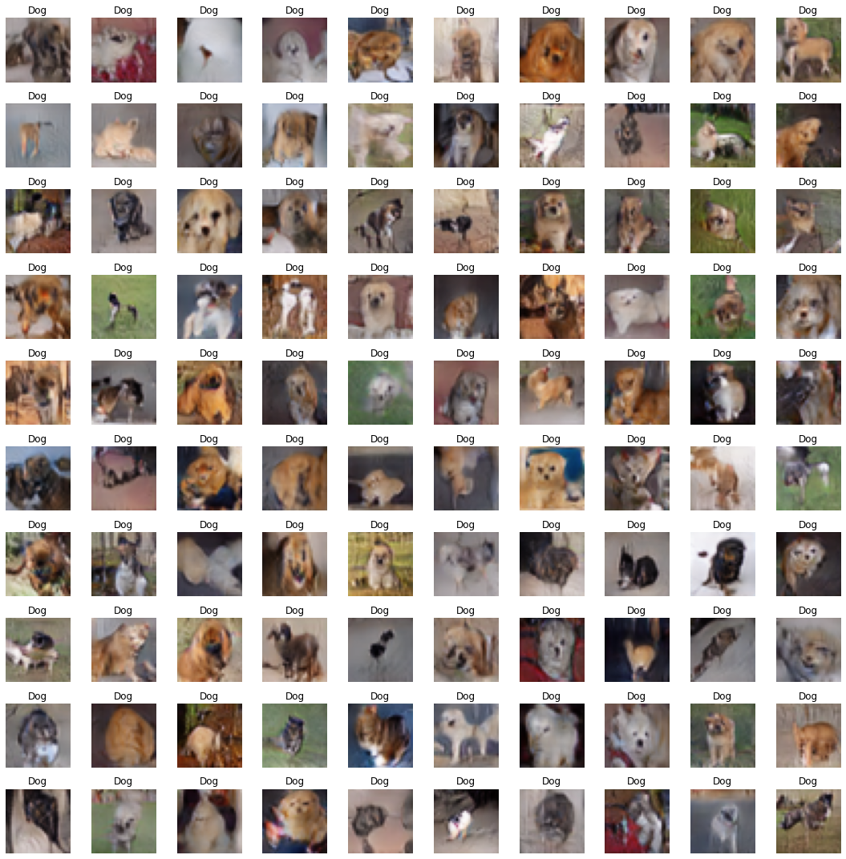
100 image per class, (Deer, Dog)
Images also look realistic for Deer and Dog

Slide 27
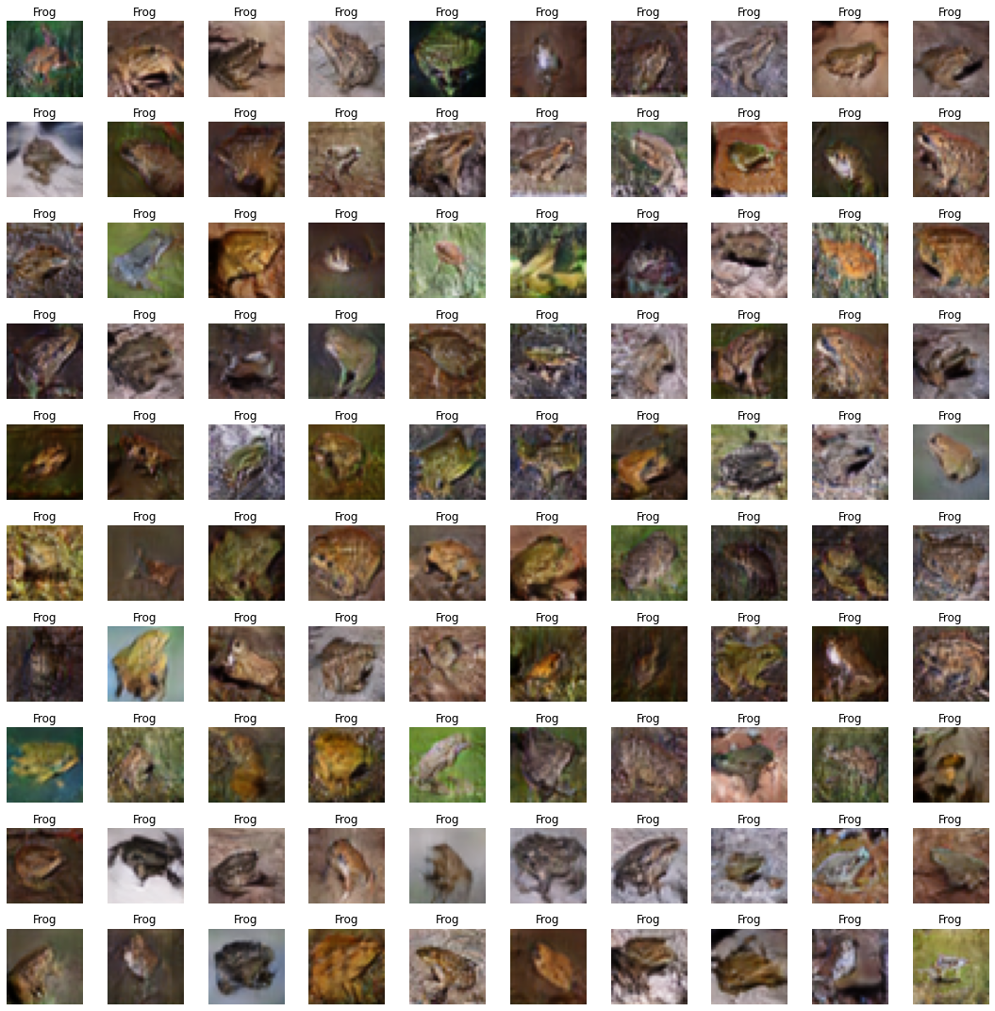
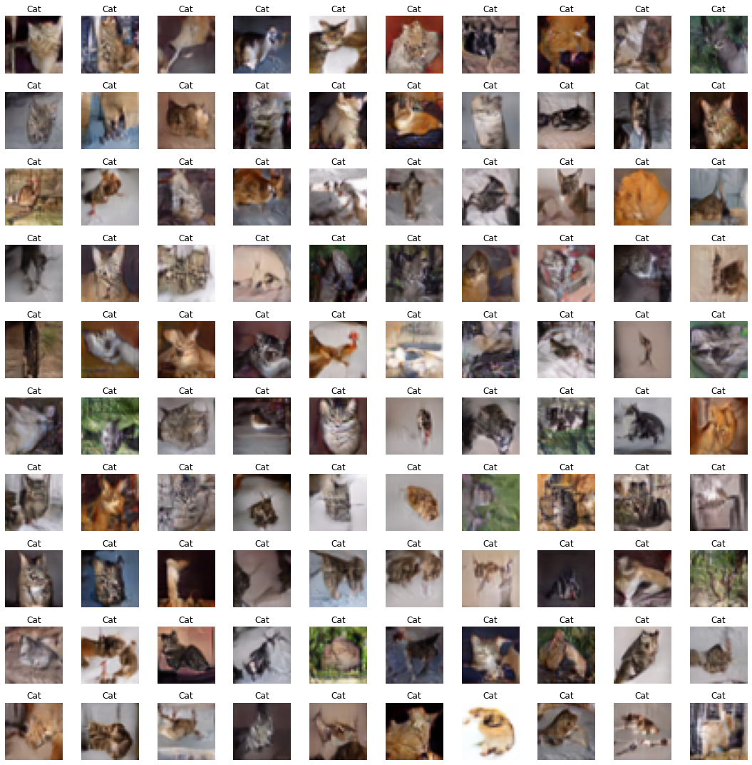
100 image per class, (Frog, Cat)
Some features of frog and cat look weird, most likely due to variety of frog and cat images that look too different in cifar10, as discovered above

